Slide 1
THE WEBINAR WILL BEGIN SHORTLY
When to go back to Programming?
Risk Management Decisions for COVID-19
by Rick Curtis
ZOOM Guidelines:
To create a safe and positive learning experience all attendees are in listen only mode.
You can post questions on the Q&A section.
Any posted questions or comments which are off-topic or considered by the presenter to be inappropriate will result in the attendee being removed from the Webinar
I will get to Q&A at the end

Slide 2
When to go back to Programming?
Risk Management Decisions for COVID-19
Rick Curtis
www.OutdoorEd.com
www.IncidentAnalytix.com
Copyright © Rick Curtis 2020
Notes:
Introduction

Slide 3
Introduction
Rick Curtis
Pronouns: he, him, his
Director, Princeton University Outdoor Action Program: 38 Years
Author: The Backpacker’s Field Manual
Founder: www.OutdoorEd.com
Founder: www.IncidentAnalytix.com
Context: US-base University outdoor program

Slide 4

Goals for Webinar
When is something that each program has to determine
Look to Guidelines from CDC, State/Federal, etc.
Explore different models & tools
Help you develop questions to ask

Slide 5
What isn’t being covered
Economics
  What is the impact of reduced or no programming
  How do we survive until we restart?
Specific protocols/guidelines
  Things are changing too fast
  Every location is different

Slide 6
When will things return to normal?
Based on the current definition of normal?
When there is a vaccine
But we can return to operating and still accomplish our mission
Normal vs Functional
  What level of operation is justifiable from economics and risk

Slide 7
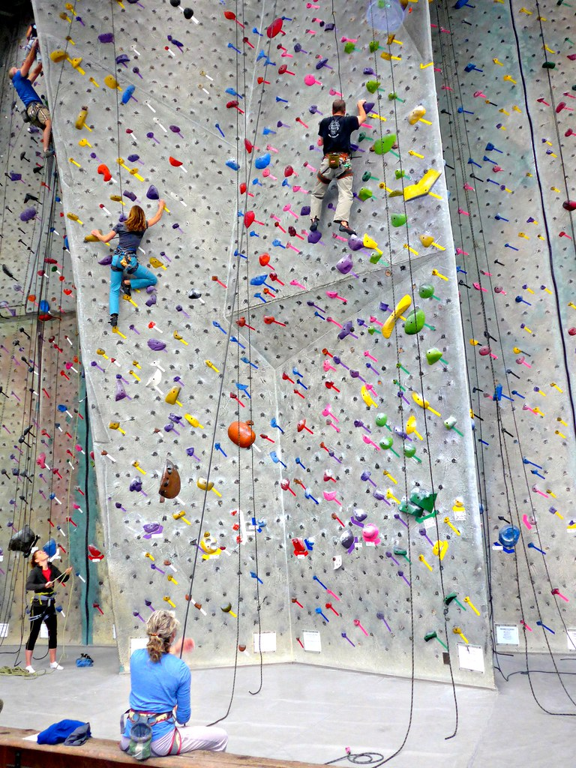
Facilities
From Social Distancing lens

Slide 8
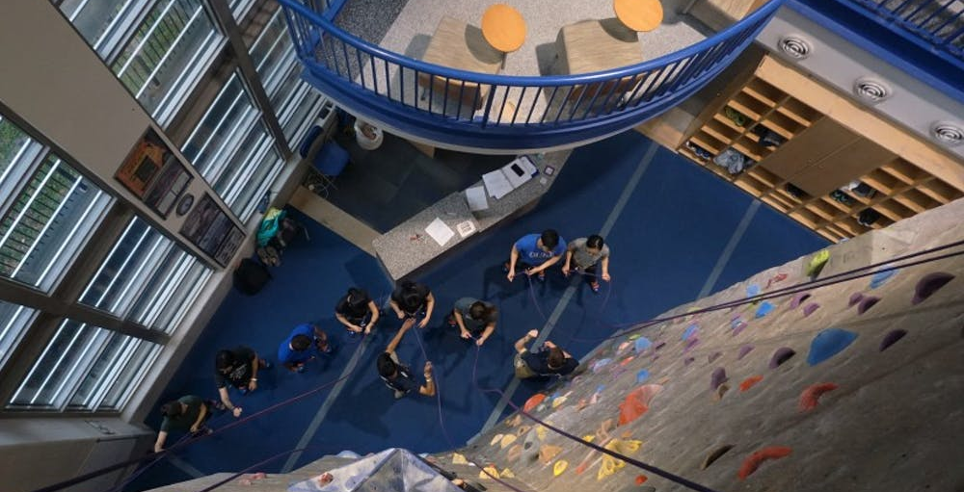
Notes:
Photo by Chris Teufel | The Chronicle
https://www.dukechronicle.com/article/2019/04/duke-what-i-learned-from-the-wilson-climbing-wall-and-other-first-year-reflections

Slide 9
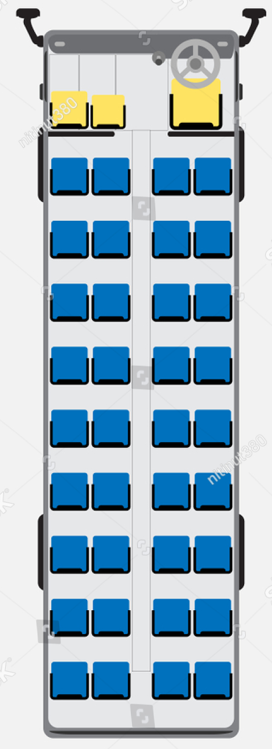

Transportation
What are your travel parameters?
Is it cost effective?
vs

Slide 10
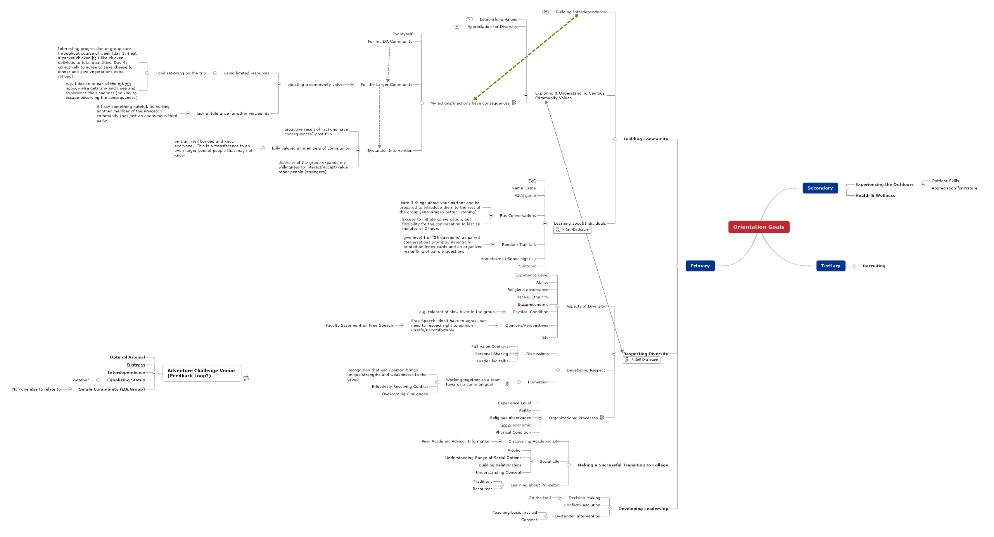
Goals vs Activities

Slide 11
Guidelines from Reputable Sources
State & Federal
CDC - https://www.cdc.gov/coronavirus/2019-ncov/community/index.html
OSHA - https://www.osha.gov/SLTC/covid-19/standards.html
Regulatory Bodies
Associations – ACCT, AMGA, ACA, AEE, AORE, CWA…
Manufacturers
  Cleaning & Sanitizing

Slide 12
When to go Back
Go Back to What?
  Full Programming?
  Partial Programming?
  Altered Programming?
  Reduced Size Programming?

Slide 13
How to go Back?
All at Once?
Staged? –
  Listen to Dr. Fauci: “You can’t just leap over things”
  Phase 1
    What Benchmarks?
    What is Cost?
  Phase 2
    What Benchmarks?
    What is Cost?
  Phase 3
    What Benchmarks?
    What is Cost?

Slide 14
Doing What?
Normal Program?
Altered Program?

Slide 15
Systems
Most of our systems have been built/evolved over time to deal with ‘normal’
“We aren’t in Kansas anymore, Dorothy”
Each of us has to create our own ‘map’ based on analysis of multiple variables
Examine our Systems/Activities in light of COVID-19
  Appropriate?
  Sufficient?
  Resilient Enough?
Safety II Thinking

Slide 16

What Will Go Wrong?
Safety I Approach

Slide 17
What Has To Go Right
Safety II Approach

Slide 18
Rasmussen’s Systems Approach
a Government level at which laws and regulations are developed;
a Regulatory level at which industry standards are developed based on laws and regulations;
a Company level where company policies and procedures based on industry standards govern work processes;
a Management level where company policies and procedures are implemented;
a Staff level representing the activities and characteristics of workers performing the processes; and
a Work level representing the equipment and environment within the work context.
https://uploadsproject.org/rasmussens-1997-risk-management-framework/
Notes:
https://uploadsproject.org/rasmussens-1997-risk-management-framework/

Slide 19
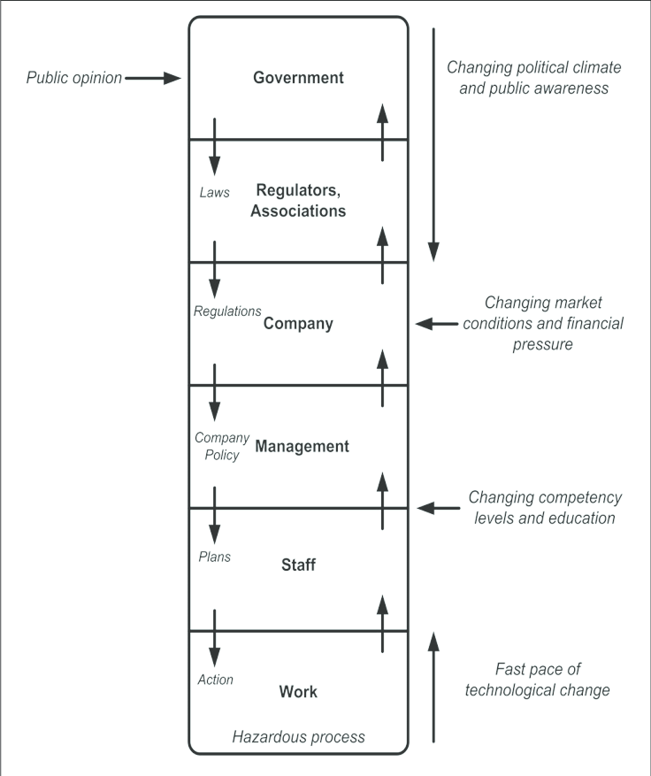
Scope of Influence
☒
Determine what you have control/influence over at each level
What happens as things open up – gray area?
  Parks open
  Group Size >10
☒
☑
☑
☑
☑

Slide 20
Tools
Paper
Whiteboard & Magnets
Charting & Drawing Programs (Creately, SmartDraw)
MindMaps
Excel & Visio
Collaboration Tools (Asana, Trello)

Slide 21
Tools to Help You Ask Questions
Decision Trees (Vertical/Horizontal)
Risk/Essential Matrix (other matrices)
Cross-Functional Flow Chart
Kanban Board
Timeline Keyframe Filter

Slide 22
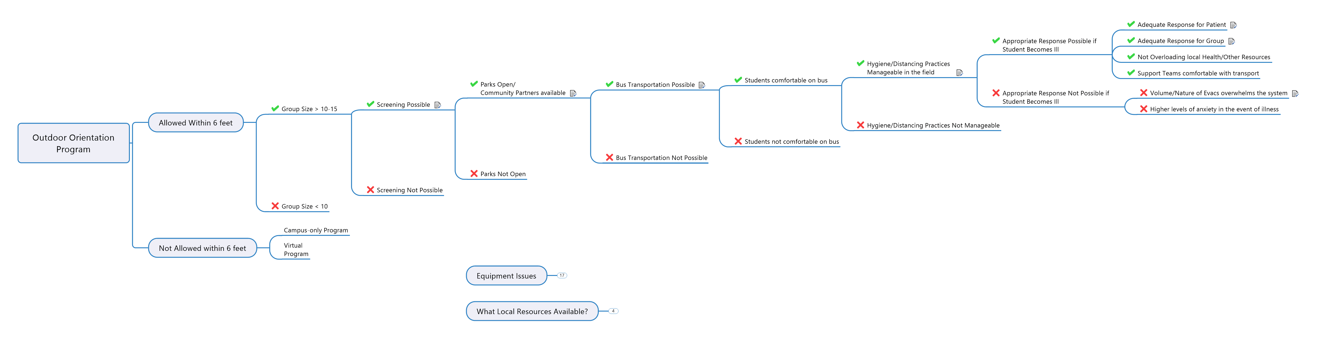
Decision Tree

Slide 23
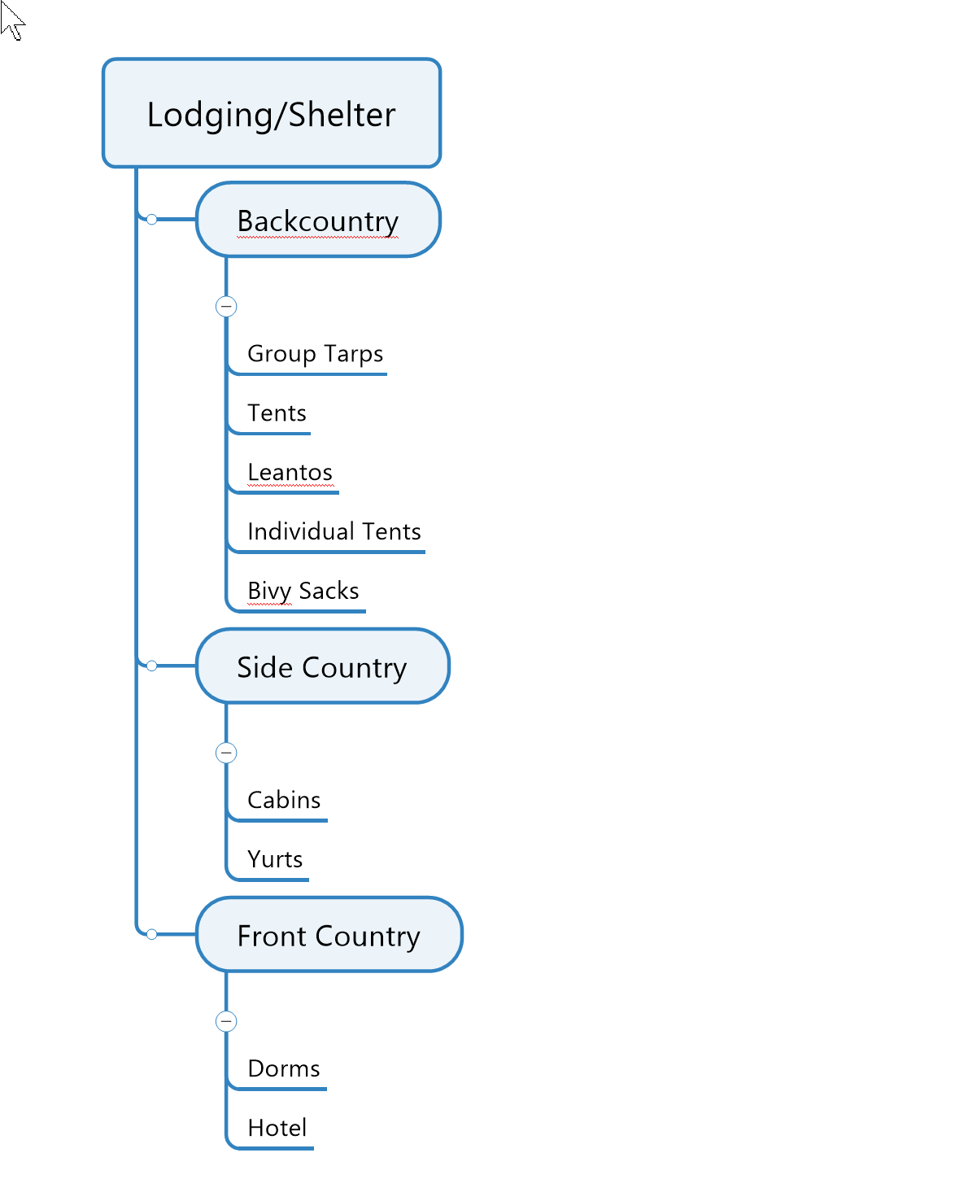
Tree Map

Slide 24
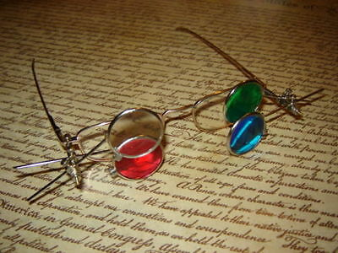
Timelines & Keyframe Filters
Movie – National Treasure

Slide 25
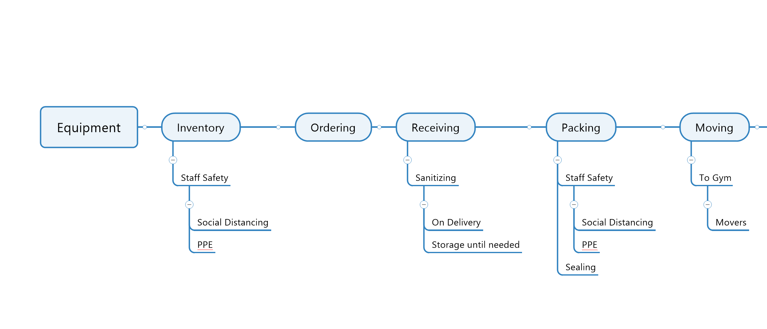
Timeline – Keyframe - Filter

Slide 26
Matrix – Risk/Essential
Numerous ways to map against a two axis matrix

Slide 27
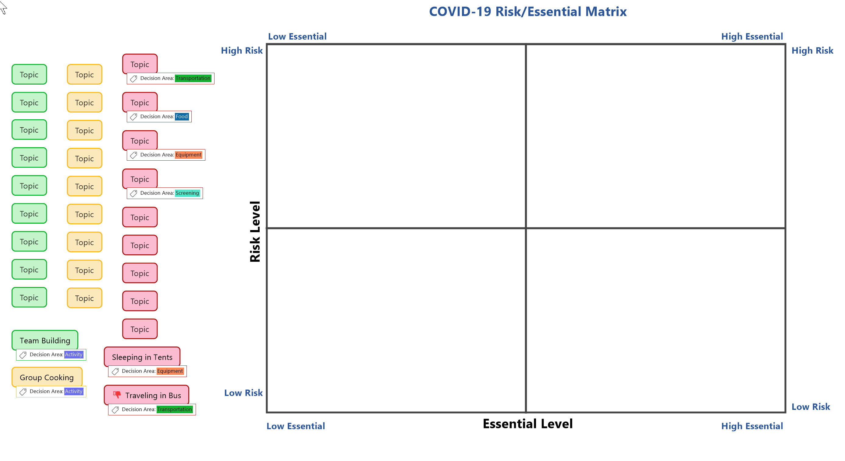

Slide 28
Kanban Cards
Another method for visualizing
Online Tools like Asana and Trello

Slide 29
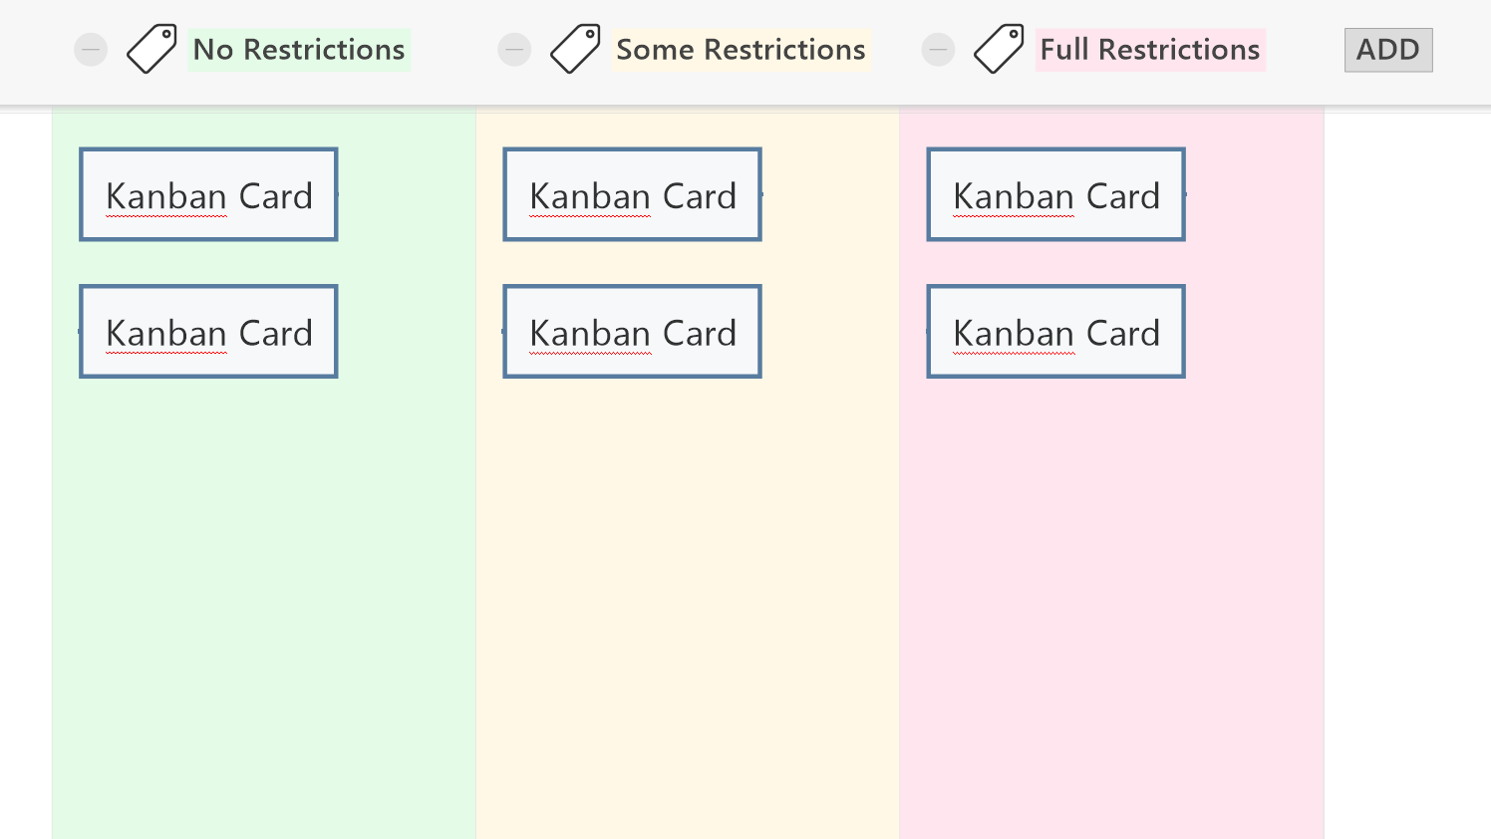

Slide 30
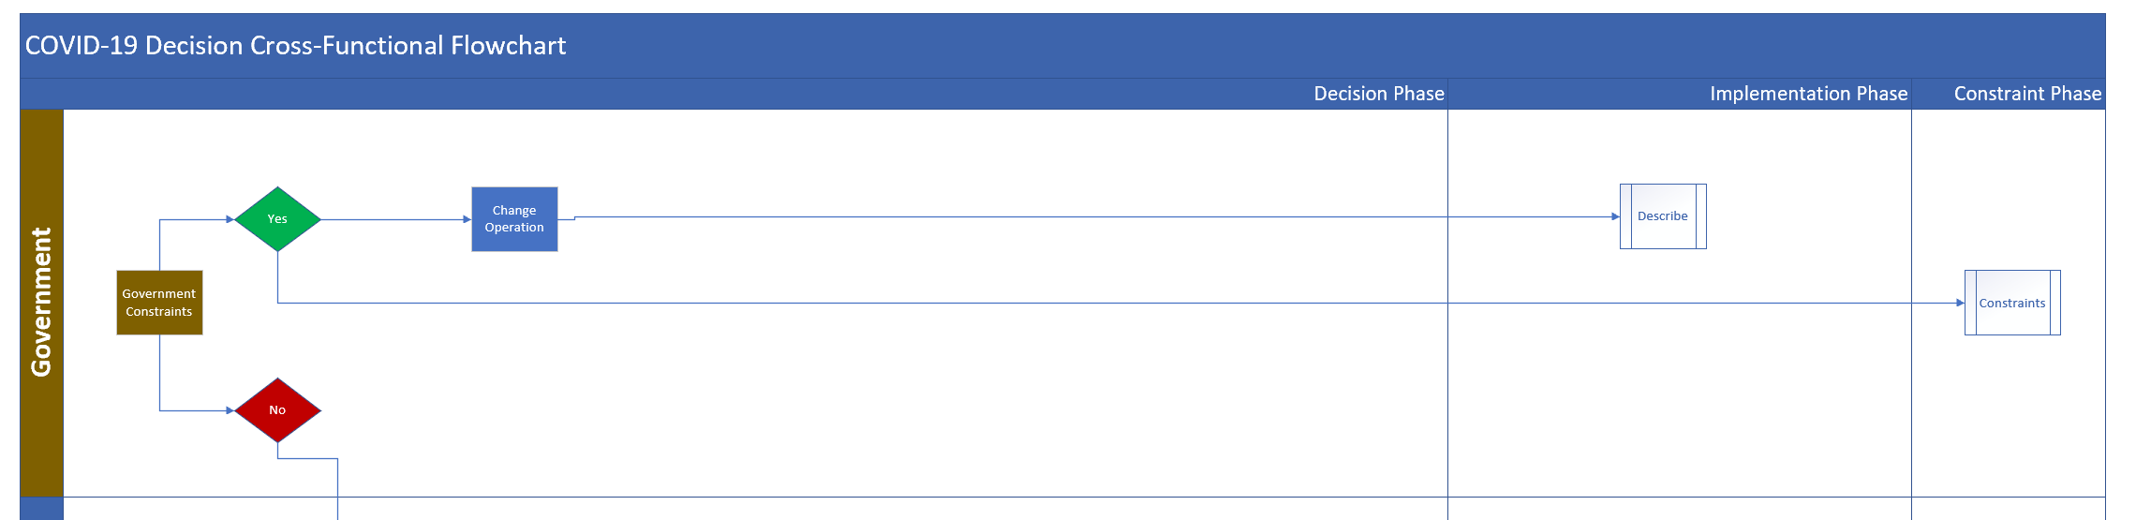
Cross Functional Flow Chart

Slide 31
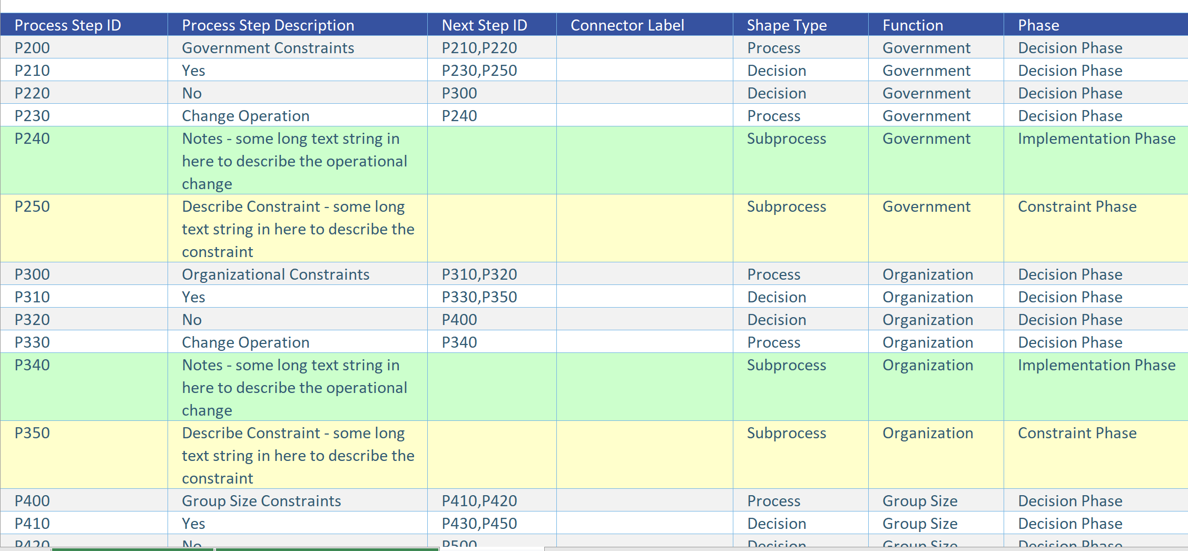
Cross Functional Flow Chart

Slide 32
Levels of Capacity
Hurricane Bonnie 1998 – Shenandoah National Park
Hurricane Irene 2011 – Entire East Coast

Slide 33
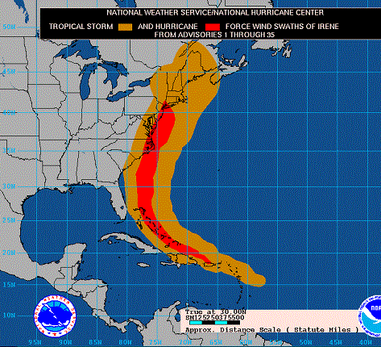
Hurricane Irene

Slide 34
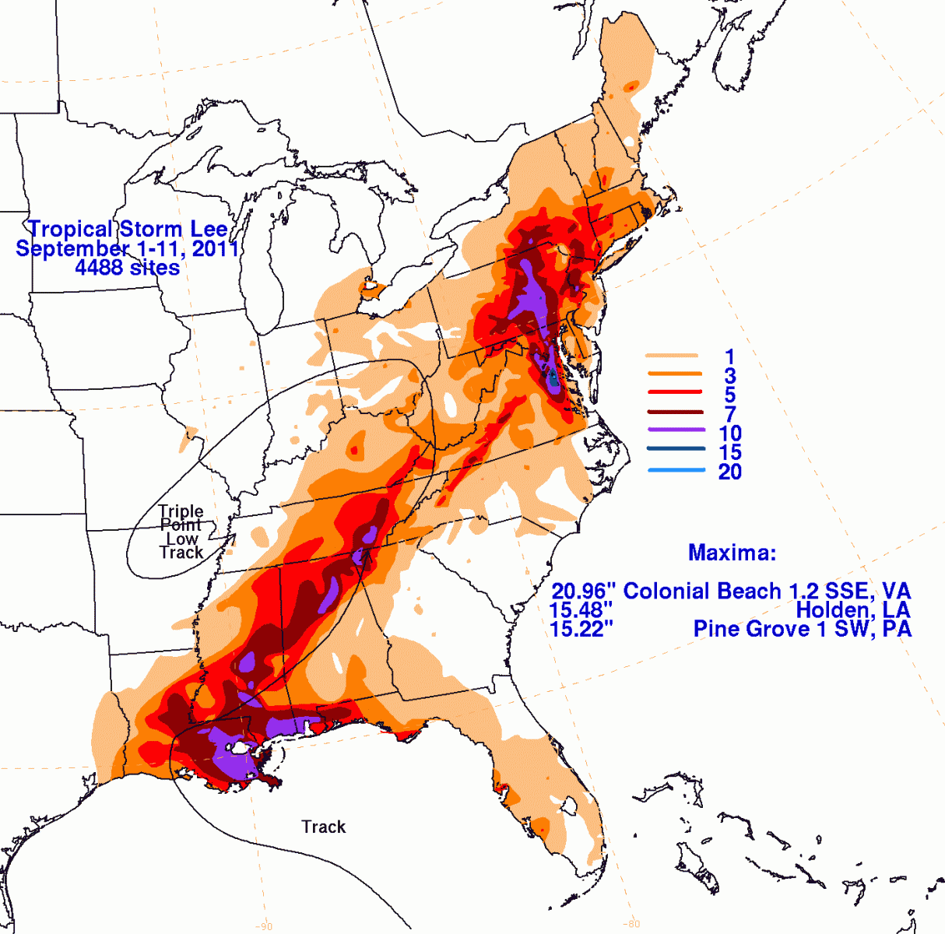
Tropical Storm Lee
Evacuated 1,000 students

Slide 35
Plan for Increasing States of…
Anxiety
  Events previously perceived as minor are now major (student with fever)
  Leading to…
 Expectations
  Local Community (ies)
  Organization
  Parents/Guardians
  Participants
  Staff
 Frequency/Volume

Slide 36
Risk Homeostasis & COVID-19?
At what point will things become normalized?
  Wearing masks and PPE
  Self-isolation on a course
When will people be ready to be in remote areas with new people and limited health care access?

Slide 37
Equipment Rental Programs
How is it ‘turned in’?
  No contact return? Storage Pod
  Do we have enough space to let it sit until cleared?
What cleaning needs to be done when gear is returned?
What is our inventory?
  Do we need to change rental dates to allow for ‘disinfect in place’?
  If we leave it for X days, is there time to properly check/inventory before it goes out again? If not, how do we reduce rental volume? Do we need to have gear rotations (A and B) to allow enough time. How does that impact program volume? If participation is decreased in Phase 1, we may be OK. What happens as participation increases?

Slide 38
Conservation Corps
Initial base camp training – screening period
Small group, isolated, often base camped, maybe within reasonable health care access
Routine assessment – temperature, etc.
Good hygiene

Slide 39
Gap Year Programs
What countries can you travel to?
What countries do you have to go through to get there?
Are you in big urban area?
  What are risks? – Population density
  What are benefits? – Healthcare access, easier departure
Are you in a rural/remote area?
  What are risks? – Population density
  What are benefits? – Healthcare access, easier departure
Are home stays possible?
Should you have an in-country quarantine site?
  On arrival for first 2 weeks?
  As an emergency backup if an outbreak?

Slide 40
Resources
www.OutdoorEd.com
www.IncidentAnalytix.com
Copyright © 2020 Rick Curtis, Outdoor Ed LLC. All rights reserved.

